Slide 1
Java FLP Project
Capgemini MIPL
20th August, 2018

Slide 2
CapStore
(E-Commerce Application)
Notes:
Usar para separador de capitulos . Seria bom ter esta versao em vermelho e verde tb..

Slide 3
CapStore Application :
CapStore is a web based e-commerce website that allows users to buy or sell products.
CapStore also allows users to sell their products, they need to register on to the website and need to be authorized by the admin of Capstore.
The CapStore Application performs the following
1. Signup, Login or Logout
2. Buy/sell products
3. Give review on products and return them.
4. Merchant- there can be two types of merchants, direct merchant and third party merchant. New merchants can be added or removed by admin. Merchants can add or remove products on CapStore.
5. Items can be added into cart and removed from the cart, after the final submission an invoice will be generated.
6. Customer can pay by different payment options
Notes:
Fixar a posicao do titulo – sempre do lado esquerdo.
Sempre que tiver muito texto o coluna deve sempre ser “ narrowed” , se nao fica dificil de ler. Colocar paragrafos no texto.
Linha vertical deve ser mais fina e as pontas NUNCA devem ser arredondadas.

Slide 4
Creating Coupons
By
Sai Deepthi Madhira
Employee Id : 153011

Slide 5
Significance of the module:
Admin needs to generate coupons and store them.
These coupons can be used by the customer at the time of checkout.
Admin will email the coupons to customers.
Notes:
Fixar a posicao do titulo – sempre do lado esquerdo.
Sempre que tiver muito texto o coluna deve sempre ser “ narrowed” , se nao fica dificil de ler. Colocar paragrafos no texto.
Linha vertical deve ser mais fina e as pontas NUNCA devem ser arredondadas.

Slide 6
Coupon Table Description
Column Name | Datatype | Key Constraints | Description
CouponId | Integer | Primary Key | Auto Generated
CouponCode | String | Unique | Name of coupon
CouponDescription | String |  | Description of Coupon
CouponAmount | Double |  | It specifies the amount that should be deducted while using the coupon
IssueDate | date |  | The date from which the coupon is valid
ExpiryDate | date |  | The date till which the coupon is valid

Slide 7
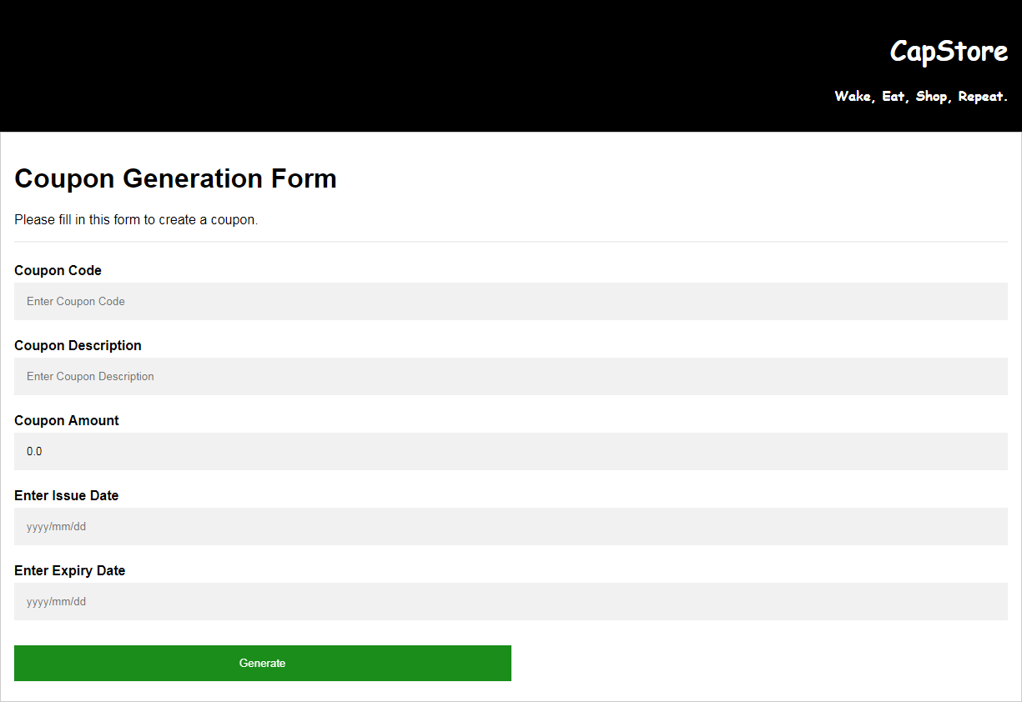
Coupon Generation Form

Slide 8
Thank You

